Slide 1
Addictive Technology
By: Ryan Castro

Slide 2
Table of Contents

Slide 3
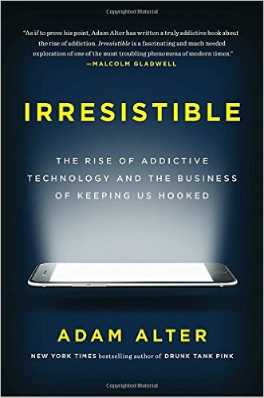
Executive Summary
After being recommended the book: Irresistible: The Rise of Addictive Technology and the Art of Keeping Us Hooked by Adam Atler, I have felt increasingly disillusioned by the growing presence of technology and various social media that has been implemented in the last decade. I used this book as inspiration for much of this report since I feel that Atler brings up very important criticisms of the growing role that technology is taking up in this generation and in future generations. As a result of this inspiration, I intend to echo many of the talking points that Atler brings up.
This report will introduce to the reader that there is the underlying problem of technology addiction amongst users today. Internet addiction will be defined by contextualizing current definitions of addiction and then showing how popular social media, business and web developers have been able to exploit subconscious reactions of humans to obtain better results for their products to a dangerous affect. Once the psychology of technology addiction is presented, the effect that such addiction has on an individual will be presented in order to demonstrate the physical results of a non-physical addiction. This report will highlight the major abusers in the industry by presenting specific anecdotes or data where there are clear signs of addiction that lead to the negative outcomes shown.

Slide 4
Introduction
A recent study by Microsoft researchers in Canada has found that since 2000, the average attention span dropped from 12 seconds to 8 seconds. The attention of an average goldfish is reported to be around 9 seconds. The Microsoft researchers attribute this eyebrow-raising result to the growing accessibility of media and internet.

Slide 5
Rise of Technology

Slide 6

Chamath Palihapitiya
(Former Facebook Exececutive)

Slide 7
Psychology of Addiction

Slide 8
Adverse Affects of Technology Addiction

Slide 9
Social Media

Slide 10
Video Streaming

Slide 11
Gaming

Slide 12
Image Sources

Slide 13
Works Cited

